Slide 1
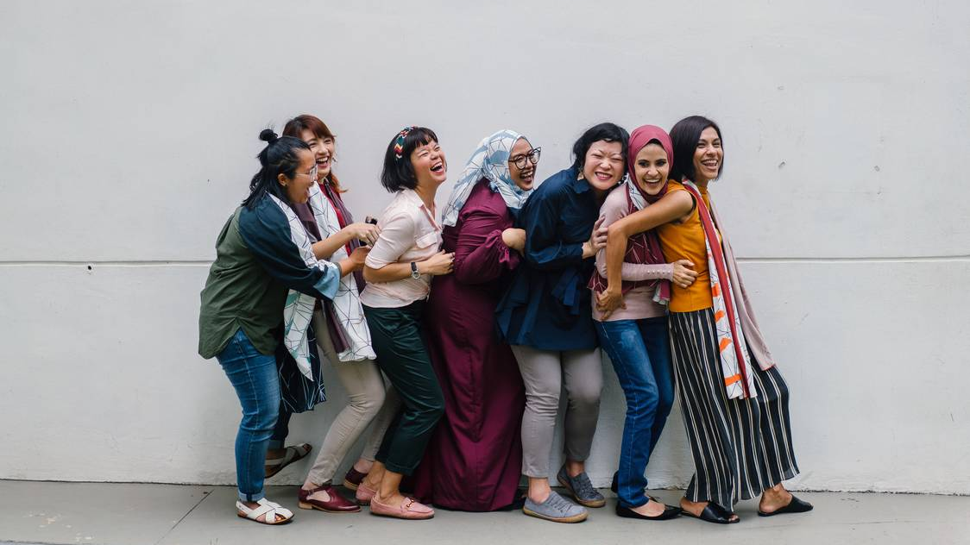

Women in
Healthcare Security
Ready to Launch
Presented By: Katie Moracco

Slide 2
Agenda
01
WIHSN Mission, Vision & Values
02
Program Overview
03
Ally & Champions
04
Key Dates & Quick Links
05
Questions

Slide 3
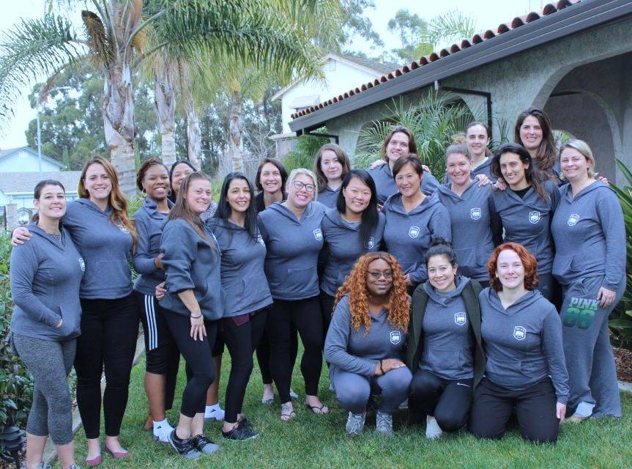
What is an ERG and why is it so valuable?
Notes:
Talking points
Liz - What is and why an ERG? Culture eats process for breakfast
Bev – What it means to her (never had anything so supportive in her career)
Jamie – What it means to her (most professional development)
Taylor – Helped her in her leadership role and to change her site’s culture

Slide 4

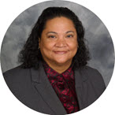

What WIHS Means to Me
Jamie Greene
“This is the most professional development I had in my whole career and it made a world of difference. It also gave me the opportunity to network with more women in our organization which ended up opening opportunity doors for me. I’ve been recently promoted, and the support of this group made the transition easier. I am so happy I joined this amazing group”
Beverly Chandler
“I never had this level of support and didn’t even realize how much difference it makes until I witnessed myself. The power of this network show itself in a number of different ways. I’m very excited to what I will do to our culture enterprise-wide”
Taylor Smith
“This network helped me develop a sense of community. I realized that none of the issues or problems I faced in management or in the security industry are unique to me. The members of the WIHS were available to guide me through some of my biggest professional challenges yet. I am grateful for taking the leap, trusting the process, and becoming a founding member!”

Slide 5
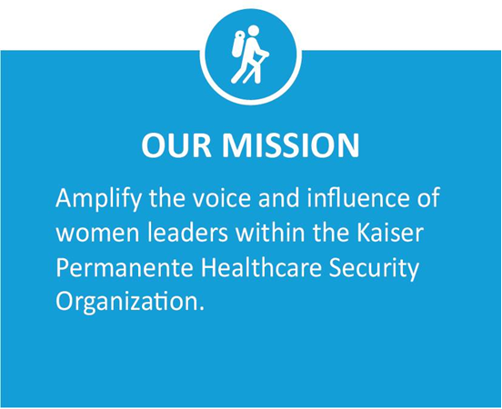
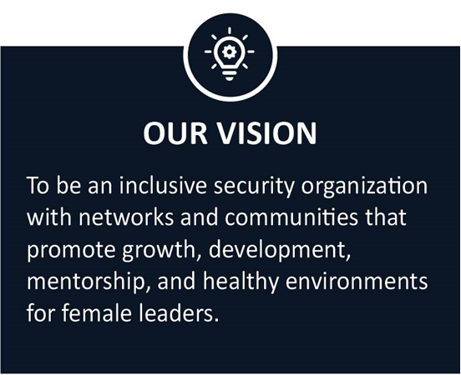
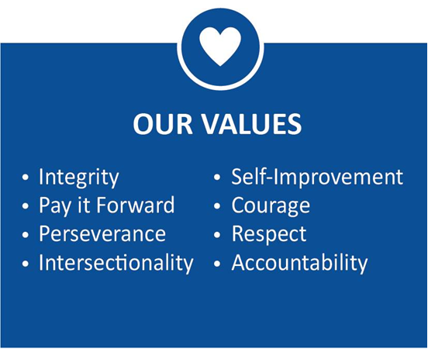
The Concept

Slide 6
WIHSN Program Overview
Mentorship Program
Research shows that mentorship increases employee performance and engagement for both the mentee and mentor. The WIHS Mentorship Program will provide formal and informal opportunities for collaboration, mentorship, and sponsorship.
Education & Scholarship Program
In the security industry, your certifications matter. Many security certifications require hours of preparation and expensive courses. The WIHS Education & Scholarship program will offer financial and study support to those interested in advancing their education through certifications, conferences, and professional development.
Ally & Awareness Program
Awareness, empathy, understanding, and allies are at the heart of any strong Employee Resource Group. Our Ally & Awareness Program will include campaigns to bring a voice to critical topics related to women in our industry, recognition for those who become strong allies, and updates on diversity topics & Total Health across the organization.
Regional Councils
The WIHS Regional Council & Site Champion Program will provide opportunities for face-to-face connection and conversation across our organization. Events will include volunteer days, book clubs, networking, industry events, and more.
Register today!
Notes:
Katie – tie back to what Bev, Jamie , Taylor said
We’re stronger together. Together we make a difference.
When we launch in October 1st, people can sign up to be a mentor or mentee
When we launch in October 1st, people can apply fort scholarships and industry events
When we launch in October 1st, people can become or nominate Allies
When we launch in October 1st, people can register for activities
Send it to Deb to show Website – out of KP network, Pin and cards

Slide 7


How can we support this effort?
We need your support as leaders - encouraging your team to join the network, supporting network members’ ability to participate in events, promoting these meaningful conversations, and being an ally to this cause.
To start, we need WIHS allies and champions for each site identified.
What does it mean to be a WIHS Ally?
What does it mean to be a WIHS Champion?
Champions are essential members of the network. They will be the local WIHS point of contact. They will help promote WIHS activities, recruit members, give us feedback from the field, and answer questions people in your location might have about the program.
They can be female or male officers, supervisors, managers, administrative assistants, or even someone from outside the security team.
Allies are security industry males or someone from outside the security industry (female or male) who advocates for equity, diversity, and inclusion. That can start with as little as being open to a conversation around these subjects or supporting diversity-focused events.
Notes:
Examples of opportunities - an alliance forms:
creating safe spaces for women to be authentic and speaking up
providing growth opportunities equally among male and female workers
giving credit where credit is due
speaking up when witnessing unfair situations
encouraging diversity and inclusion dialogs with other colleagues
having awareness about women’s challenges
Can anyone be a WIHS Champion and Ally? YES! Anyone willing to support this great program, looking for an opportunity to lead a cause locally, and influence our culture positively.

Slide 8
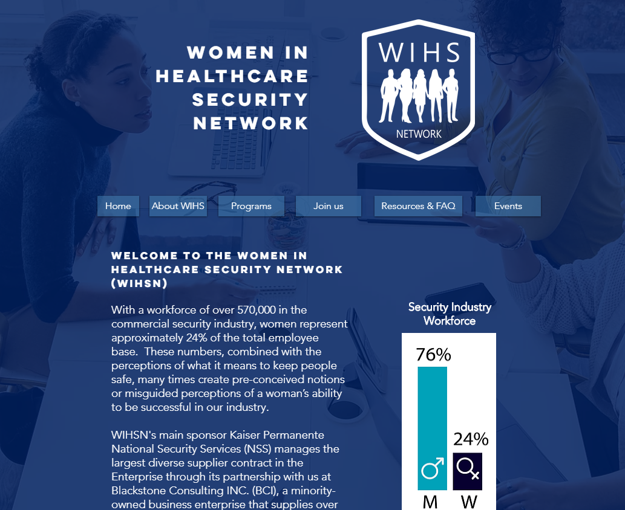
Key Dates
WIHS Socialization & Champions Recruitment: August 5th-September 10th
Champions Registration Deadline: September 15th
Champions Onboarding: September 21st – 23rd
WIHS Network Official launch: October 1st
Pins Distribution & Members Registration:
October 1st - 20th (and on-going after that)
WIHS Network First Event: Leadership Webinar Mid-October
Quick Links
Socialization & Champion Recruitment Toolkit
WIHS Network Registration Form
Ally Nomination Form
WIHS page
Visit our WIHS page to learn more

Slide 9
Q&A
Thank you for your valuable time!

